Slide 1
Becoming Fruitful
in 2019

Slide 3
Becoming Fruitful
in 2019

Slide 4
“I am the true vine, and my Father is the gardener. He cuts off every branch in me that bears no fruit, while every branch that does bear fruit he prunes so that it will be even more fruitful. You are already clean because of the word I have spoken to you. Remain in me, and I will remain in you. No branch can bear fruit by itself; it must remain in the vine. Neither can you bear fruit unless you remain in me.”
—John 15:1-4

Slide 5
Submit to Christ
(vv. 1-4)

Slide 6
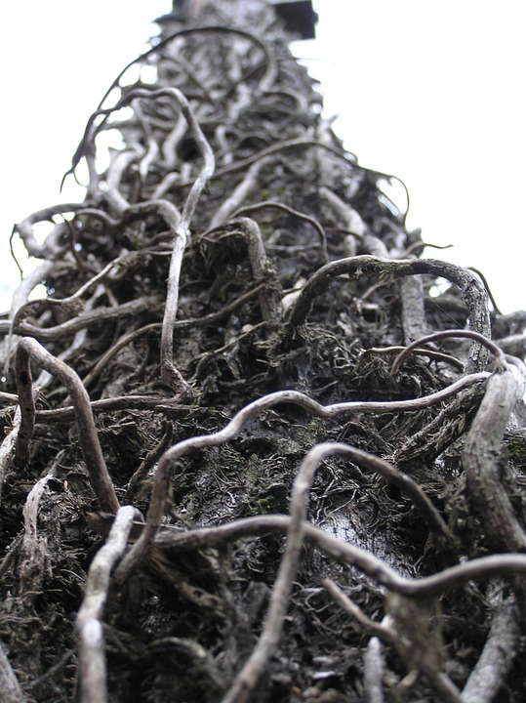
“I will sing for the one I love a song about his vineyard: My loved one had a vineyard on a fertile hillside. He dug it up and cleared it of stones and planted it with the choicest vines. He built a watchtower in it and cut out a winepress as well. Then he looked for a crop of good grapes, but it yielded only bad fruit..”
—Isaiah 5:1-2

Slide 7
“Pruning” is the Lord’s discipline.
“He cuts off every branch in me that bears no fruit, while every branch that does bear fruit he prunes so that it will be even more fruitful.”
—John 15:2

Slide 8
Jesus warns his disciples to stay connected.
“You are already clean because of the word I have spoken to you. Remain in me, and I will remain in you. No branch can bear fruit by itself; it must remain in the vine. Neither can you bear fruit unless you remain in me.”
—John 15:3-4

Slide 9
Commit
to the
Church

Slide 10
Remain in fellowship
with Christ
(vv. 5-8)

Slide 11
“I am the vine; you are the branches. If a man remains in me and I in him, he will bear much fruit; apart from me you can do nothing. If anyone does not remain in me, he is like a branch that is thrown away and withers; such branches are picked up, thrown into the fire and burned. If you remain in me and my words remain in you, ask whatever you wish, and it will be given you. This is to my Father’s glory, that you bear much fruit, showing yourselves to be my disciples.”
—John 15:5-8

Slide 12
We remain in Christ by being connected to his word and through prayer.
“If you remain in me and my words remain in you, ask whatever you wish, and it will be given you.”
—John 15:7

Slide 13
We remain in Christ by being connected to his word and through prayer.
“This is to my Father’s glory, that you bear much fruit, showing yourselves to be my disciples.”
—John 15:8

Slide 14
Commit
to the
Word

Slide 15
“As the Father has loved me, so have I loved you. Now remain in my love.”
—John 15:9

Slide 16
Remain in Christ’s love
(vv. 9-17)

Slide 17
“As the Father has loved me, so have I loved you. Now remain in my love. If you obey my commands, you will remain in my love, just as I have obeyed my Father’s commands and remain in his love. I have told you this so that my joy may be in you and that your joy may be complete. My command is this: Love each other as I have loved you. Greater love has no one than this, that he lay down his life for his friends.”
—John 15:9-13

Slide 18
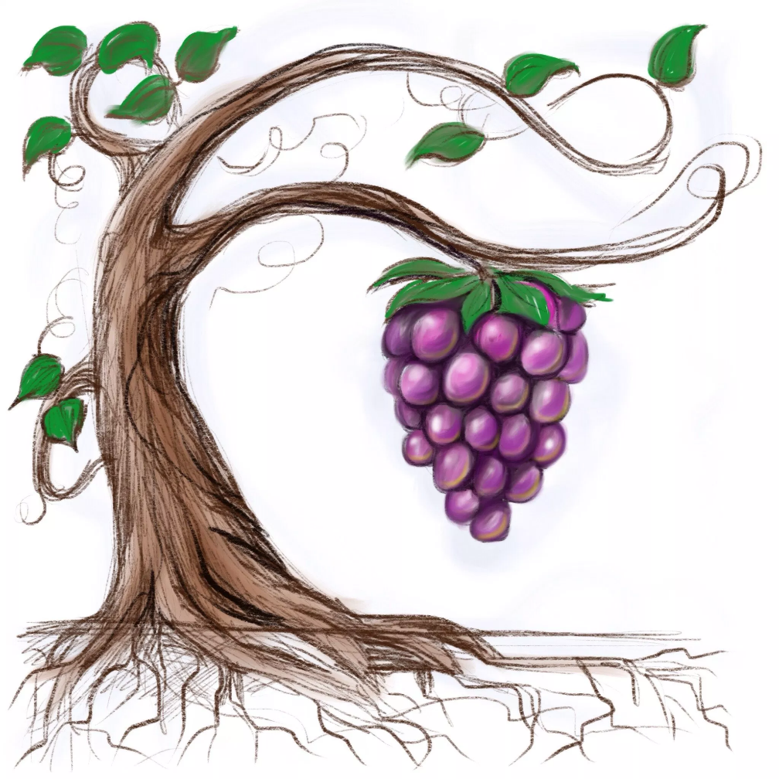
Three results of sacrificial love:
Joy
“I have told you this so that my joy may be in you and that your joy may be complete.”
—John 15:11

Slide 19
Three results of sacrificial love:
Friendship with God
“You are my friends if you do what I command. I no longer call you servants, because a servant does not know his master’s business. Instead, I have called you friends, for everything that I learned from my Father I have made known to you.”
—John 15:14-15

Slide 20
Three results of sacrificial love:
Lasting fruit
“You did not choose me, but I chose you and appointed you to go and bear fruit—fruit that will last. Then the Father will give you whatever you ask in my name.”
—John 15:16

Slide 21
Commit
to a
BFG
(and love them)

Slide 22
Commit to the church
Commit to the Word
Commit to a BFG

