Slide 1
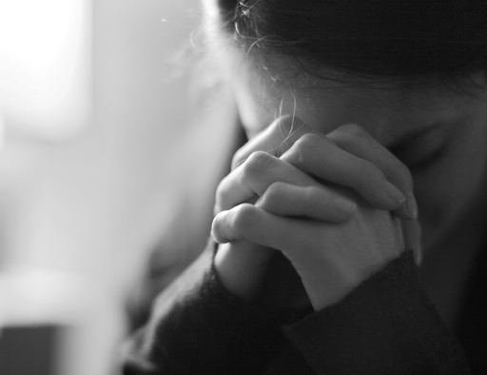
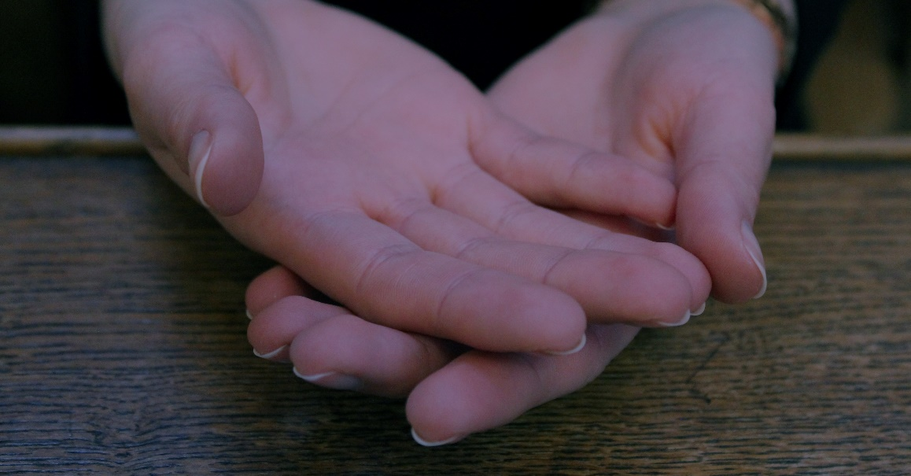
Spending Time with God: Training for Godliness

Slide 2
… Jesus went into Galilee, proclaiming the good news of God. “The time has come,” he said. “The kingdom of God is near. Repent and believe the good news!”
- Mark 1:14-15
What is the gospel of Jesus?
Notes:
**What is the gospel of Jesus?
Mark 1:14-15
**What’s the good news here? (kingdom of God is near)
**What two responses does he call for first? (repent and believe)
People often confuse this message with a different one…

Slide 3
“Gospel of minimum-requirements-to-get-into-heaven-when-you-die”
Notes:
“Gospel of minimum requirements”
“Do you have to do these things?” we ask…
Misses the point… misses that it’s good news… that kingdom of God is near, not way up there!
Jesus never answered this question!
He does teach us how to live in the kingdom… two prominent images…

Slide 4
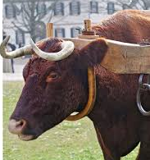
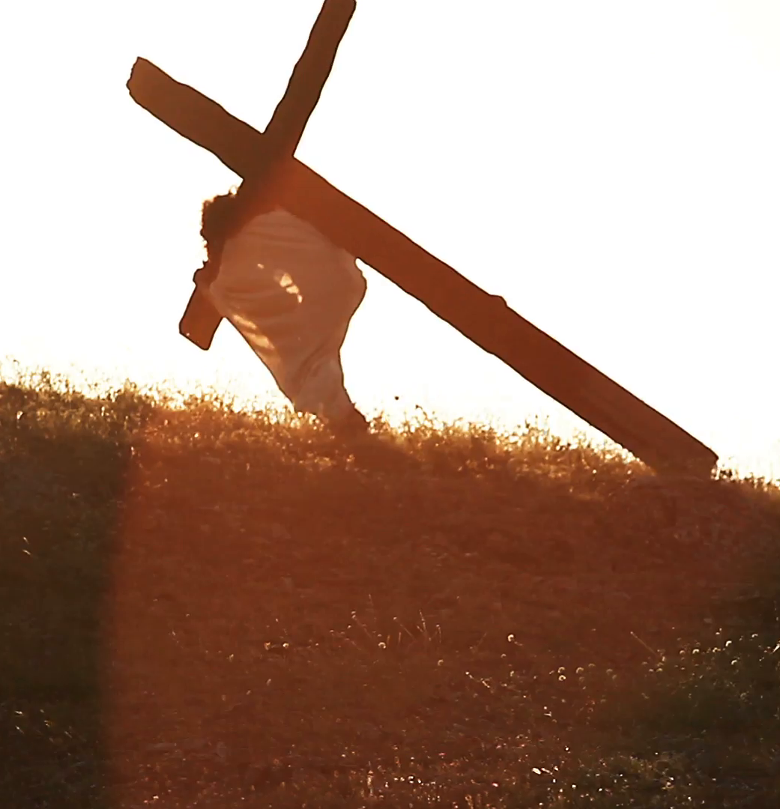
“Come to me, all you who are weary and burdened, and I will give you rest. Take my yoke upon you and learn from me, for I am gentle and humble in heart, and you will find rest for your souls. For my yoke is easy and my burden is light.”
- Matthew 11:28-30
Then he said to them all: “If anyone would come after me, he must deny himself and take up his cross daily and follow me.”
- Luke 9:23
Notes:
One is the easy yoke…
Matthew 11:28-30
The other is the cross…
Luke 9:23
How can both be true?

Slide 5
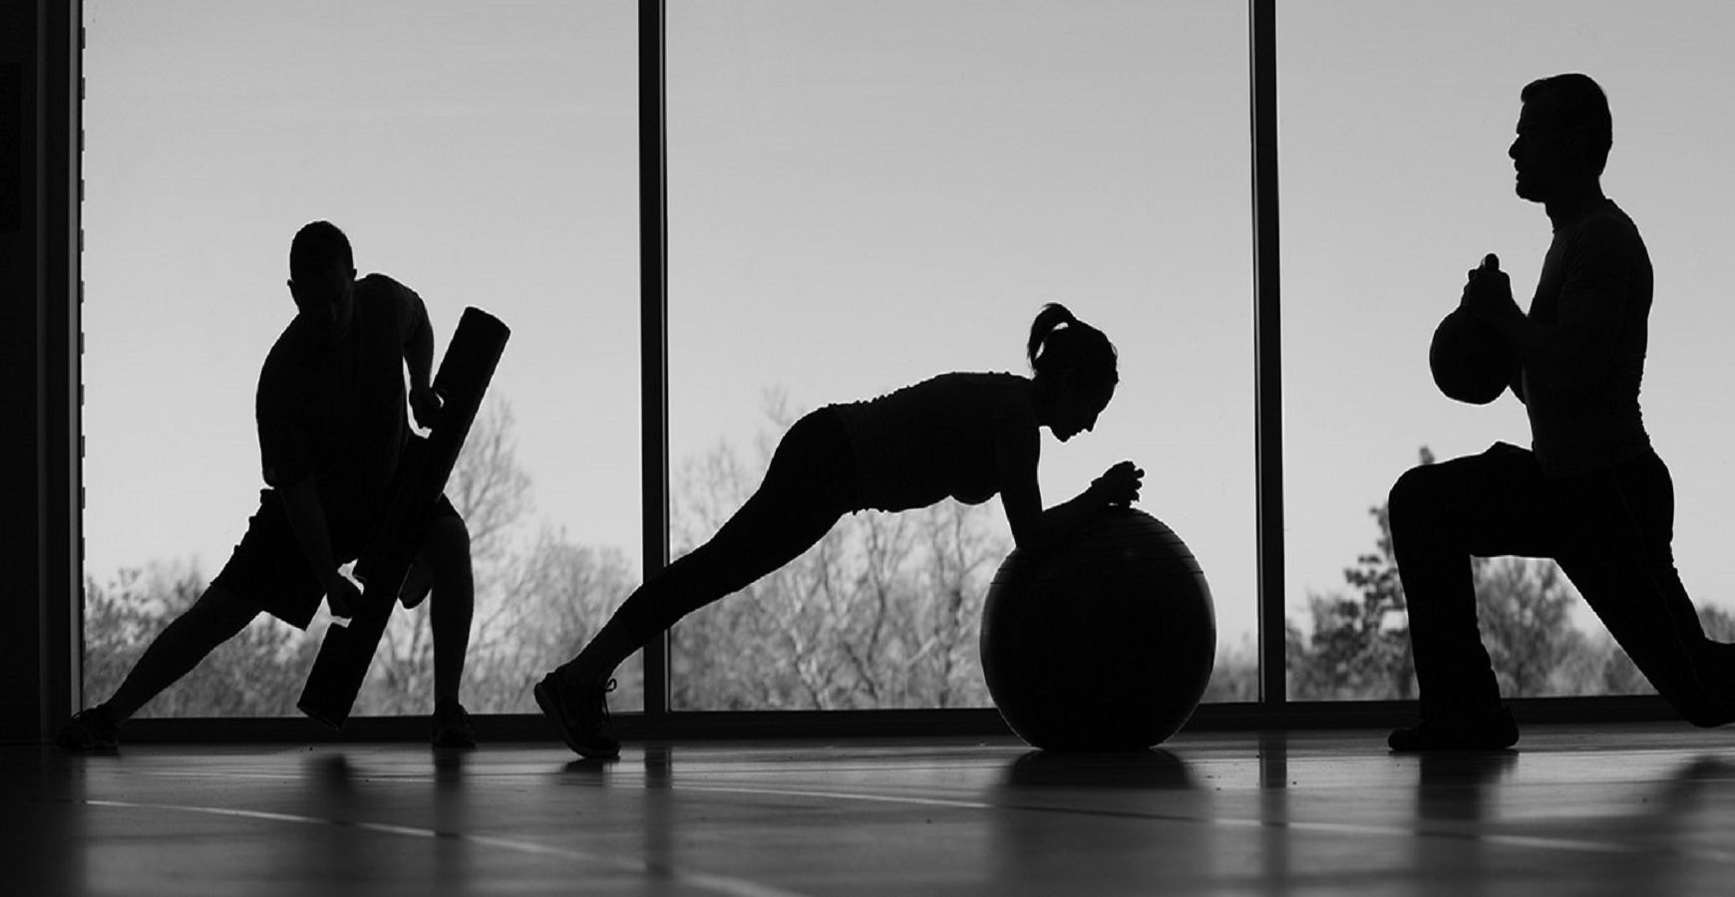
… Train yourself to be godly. For physical training is of some value, but godliness has value for all things, holding promise for both the present life and the life to come.
- 1 Timothy 4:7-8
Notes:
**What’s the difference between Paul saying “try to be godly” and “train to be godly”?
What is the difference between training and trying?
Go over some examples…
Baking a cake…
Fixing a car…
Running distance….
Performing surgery…
It’s impossible to do anything but “try” (and fail) unless you have trained…
But there’s a reason people don’t achieve all that they could…

Slide 6
Training is Hard
… No, I beat my body and make it my slave so that after I have preached to others, I myself will not be disqualified for the prize.
- 1 Corinthians 9:27
Notes:
To decide to train is to reject the gospel of minimum requirements…
More of that passage: vv. 24-27

Slide 7
Do you not know that in a race all the runners run, but only one gets the prize? Run in such a way as to get the prize. Everyone who competes in the games goes into strict training. They do it to get a crown that will not last; but we do it to get a crown that will last forever. Therefore I do not run like a man running aimlessly; I do not fight like a man beating the air. No, I beat my body and make it my slave so that after I have preached to others, I myself will not be disqualified for the prize.
- 1 Corinthians 9:24-27
Notes:
More of that passage: vv. 24-27…
How do you run to get the prize? By trying harder?
That’s how it works in movies… “want it more”… but winning teams don’t “want it more” @ game but @ practice…
**What are some of the skills you are trained in? Was training easy?
Re-read v. 27…
Training is hard… We know this to be true… (physical training) So people shy away into the disobedience of outward religion

Slide 8
“To depart from righteousness is to choose a life of crushing burdens, failures, and disappointments, a life caught in the toils of endless problems that are never resolved… The ‘cost of discipleship,’ though it may take all we have, is small compared to the lot of those who don’t accept Christ’s invitation to be a part of his company in the Way of life.”
- Dallas Willard
Notes:
But disobedience is harder: Willard quote…
Liz fixing the girls hair… not guaranteed to be pain-free… lots more pain if they fight and pull away…
This is where Jesus’ promise of the easy yoke comes in…

Slide 9
“Come to me, all you who are weary and burdened, and I will give you rest. Take my yoke upon you and learn from me, for I am gentle and humble in heart, and you will find rest for your souls. For my yoke is easy and my burden is light.”
- Matthew 11:28-30
Notes:
“Easy yoke” is a result of training…
Illustration: January mile v. half-marathon
**what else has become easy for you with training?
Ortberg: We tend to exaggerate what we can do through trying and underestimate what we can do through training…
So we give up trying and don’t train… We trade temporary discomfort for constant pain.
So what does it mean to train for godliness?

Slide 10
Training for godliness is to intentionally and systematically submit your body to God.
Therefore, I urge you, brothers, in view of God’s mercy, to offer your bodies as living sacrifices, holy and pleasing to God—this is your spiritual act of worship. Do not conform any longer to the pattern of this world, but be transformed by the renewing of your mind. Then you will be able to test and approve what God’s will is—his good, pleasing and perfect will.
- Romans 12:1-2
In the same way, count yourselves dead to sin but alive to God in Christ Jesus. Therefore do not let sin reign in your mortal body so that you obey its evil desires. Do not offer the parts of your body to sin, as instruments of wickedness, but rather offer yourselves to God, as those who have been brought from death to life; and offer the parts of your body to him as instruments of righteousness. For sin shall not be your master, because you are not under law, but under grace.
- Romans 6:11-14
Notes:
Training for godliness is to intentionally and systematically submit your body to God.
Romans 12:1-2—“read”
Romans 6:11-14—“read”
This is what is known as spiritual disciplines… using particular exercises to bring yourself more and more into submission to God…

Slide 11
“To train means arranging our life around those practices that enable us to do what we cannot do by direct effort.”
- John Ortberg

Slide 12
“Spiritual disciplines: Training exercises to give us power to live in the kingdom.”
- John Ortberg
Notes:
Disciplines → “disciple”

Slide 13
“Purpose: To enable you to do the right thing at the right time in the right spirit.”
- John Ortberg
Notes:
Purpose of spiritual disciplines…
Includes different parts of life… brain … thoughts… tongue… time… stomach… possessions… affections… all have disciplines and we’re going to look at them…

Slide 14
Notes:
**hand out cards**
Spiritual Disciplines (insert)
Disciplines of abstinence/ engagement (Willard)
Inward/outward/corporate disciplines (Foster)
Plan going forward…
Learn and practice some of these disciplines….
Submission is a key part…
Offer yourself to God… allow yourself to be led
Trust yourself to the church… do this together…

