Slide 1
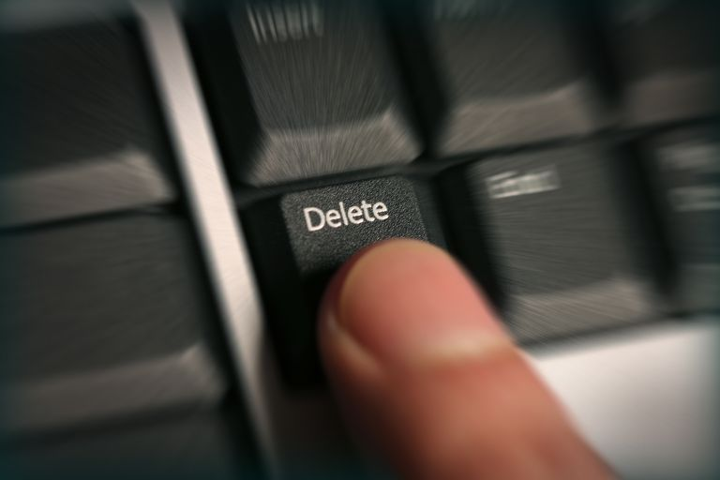
Forgiveness
Part 7: Strategies for Forgiveness – The Small Stuff
Notes:
Back in college, I changed my phone service to MCI—I believe it was—in order to take advantage of this certain offer…
Back in the days of paid long distance
10-10-321, etc.
Free Monday nights! (restrictions apply…)
Cruising along… going over time, so it’s about time to hang up… then I say it… I don’t know what I said, but I said it… That’s how you end up with $200 long-distance bills
Between that and 5-plus years as a youth minister trying to foster unity among a group of dozens of teenagers, I sort of became a student of conflict…
Conflict begins will envy and selfish attitudes and pride, ignites at the moment of offense and anger, and then runs on unforgiveness and bitterness.
If we are going to love one another, we’ve got to interrupt this process…
Next 3 weeks: strategies for forgiveness
Using Hybels’ 3 levels of offense…
Category 1: minor offenses
Category 2: legitimate wounds
Category 3: life-shattering injustices
Today: low-level offenses… when little things become big… How do you learn not to be tripped up by these things?

Slide 2

Love is patient, love is kind. It does not envy, it does not boast, it is not proud. It is not rude, it is not self-seeking, it is not easily angered, it keeps no record of wrongs. Love does not delight in evil but rejoices with the truth. It always protects, always trusts, always hopes, always perseveres.
—1 Corinthians 13:4-7
Notes:
Going to look at 1 Cor. 13:4-7—“read”…
Asking three important questions…

Slide 3

?
Notes:
Why am I angry?
“Love is patient”…
“Love suffers long”… it’s a verb…
Patience requires you to think of others…
Often anger comes from expecting someone to change immediately… children… wife/husband…
We feel slighted because someone hasn’t learned fast enough to prevent our current inconvenience…

Slide 4

A wise person is patient.
A man’s wisdom gives him patience; it is to his glory to overlook an offense. —Proverbs 19:11
Notes:
But a wise person is patient…
Proverbs 19:11—“A man’s wisdom gives him patience; it is to his glory to overlook an offense.”
This is one of my favorite verses… a key verse in getting along with people…
Some people pride themselves in being able to seek out the hidden motives of others…
In fact, it is to your glory—it shows your progress, your emerging Christ-likeness—to overlook the offense.
Much better to turn your attention to yourself…

Slide 5

Anger over little stuff reveals something about our own heart.
Notes:
Wisdom tells us our anger over little stuff reveals something about our own heart… v. 4…
Before you jump on people for something small, first look at yourself… Why so angry?
We can see three reasons why we are often angered by minor offenses…

Slide 6
?
jealousy
Love is patient…it does not envy…
—1 Corinthians 13:4
Notes:
“does not envy”→ jealousy
We imagine/take offense when someone has something we want for ourselves…
(Martha’s anger @ Mary→ she wanted to sit, too)

Slide 7
?
image
Love is patient…it does not boast…
—1 Corinthians 13:4
Notes:
“does not boast”→ our image is disrupted
Image about ourselves is shattered… something revealed about our life, relationship, abilities, that we dislike

Slide 8
?
pride
Love is patient…it is not proud…
—1 Corinthians 13:4
Notes:
“is not proud”→our pride…
Often about “respect” (“dissing”)
If we can be honest with ourselves about the source of our anger, we can then ask the next question…

Slide 9

What is the
?
Notes:
What is the truth?
Edgar Allan Poe story: “Cask of Amontillado”
“The thousand injuries of Fortunato I had borne as I best could, but when he ventured upon insult I vowed revenge.”
Story… was the “insult” even real?!

Slide 10

Christians should be nearly
[Love] is not rude, it is not self-seeking, it is not easily angered…
—1 Corinthians 13:5
Notes:
“Not easily angered”→Christians should be nearly “unoffendable”
Extend grace: we’re all clumsy…
Love is not rude… doesn’t shamefully expose... instead is gentle
Love isn’t self-seeking→not only looking out for ourselves…
But we’re all clumsy in these ways… love isn’t set off and offended when people make mistakes… instead, we expect that if we get close to someone, we’ll see their clumsiness, their rough edges and unfinished parts…

Slide 11

Throw out the ledger!
…[Love] keeps no record of wrongs…
—1 Corinthians 13:5
Notes:
Instead, love “keeps no record of wrongs”
Anger festers when the debt grows… when small things turn into big debt…
Throw away the ledger! Small things don’t have to add up…

Slide 12

Seek the truth.
Everyone should be quick to listen, slow to speak and slow to become angry.
—James 1:19
Notes:
Love doesn’t “delight in evil… rejoices in the truth”
Seek the truth…
Sometimes we delight in finding ways to hold something against others: Don’t look for reasons to be angry… to be the victim…
Listen instead: James 1:19—“Everyone should be quick to listen, slow to speak and slow to become angry”

Slide 13
Listen instead of assuming.
Everyone should be quick to listen, slow to speak and slow to become angry.
—James 1:19
Notes:
Listen instead of assuming…
If you get angry quickly, you’ve already created a barrier of pride… you want to justify your anger… to be “right”
Can’t admit an assumption… “Leah story”
Even if you still believe you are justified, last Q:

Slide 14

Notes:
Is it worth it?

Slide 15
He who covers over an offense promotes love, but whoever repeats the matter separates close friends.
—Proverbs 17:9
Notes:
Proverbs 17:9—“He who covers over an offense promotes love, but whoever repeats the matter separates close friends.”
“separates close friends”: Is it worth it? Really?
Are you really going to make this the reason the relationship is broken?

Slide 16
Starting a quarrel is like breaching a dam; so drop the matter before a dispute breaks out.
—Proverbs 17:14
Notes:
Prov. 17:14—“Starting a quarrel is like breaching a dam; so drop the matter before a dispute breaks out.”

Slide 17
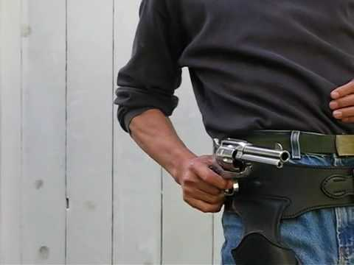
Learn to be a “forgiveness quick-draw!”
Notes:
Learn to be a forgiveness “quick-draw”…
Shoot down offense before it even takes root
Don’t allow yourself to be offended…

Slide 18
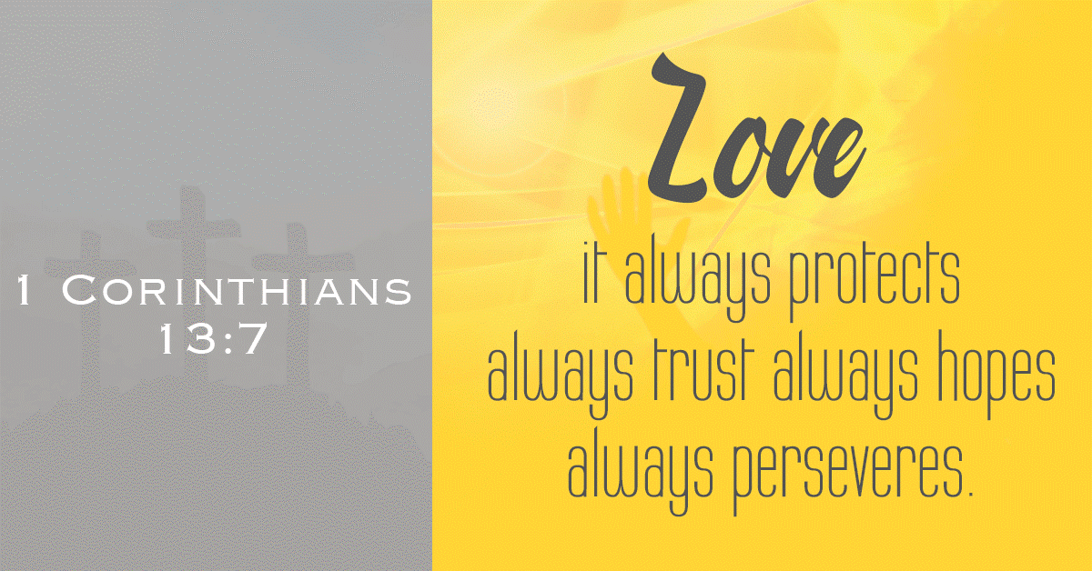
Notes:
How? 1 Cor. 13:7—“read”
Protect the reputation of that person in your mind… trust in their good intentions… their love for you…

Slide 19
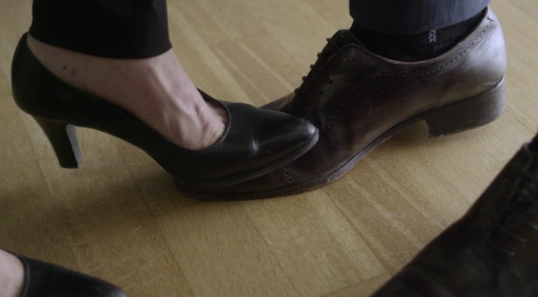
Assume the best instead of the worst.
[Love] always protects…always trusts
—1 Corinthians 13:7
Notes:
That means assuming the best instead of the worst
Illustration: say you stepped on my toe…
What do I assume about you?
Say it was in-grown… might be more likely to get angry b/c it hurt more… does not change your intention…
But even when they are clumsy and hurt us… even when they are being selfish or rude or should have known better…

Slide 20

Expect them to be better.
[Love] always hopes…always perseveres
—1 Corinthians 13:7
Notes:
… Love always hopes, love always perseveres… We expect them to be better…
They are in process, just like we are…
What’s more important? Love or absolute fairness? God has extended us grace because his love for you was more important…

Slide 21
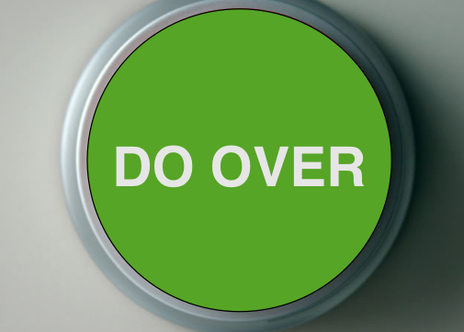
Notes:
Maybe that’s what you need in your relationship: your marriage… a family relationship… a friendship… a relationship within the church…
Throw the ledger away… start fresh… assume the best… give grace…

Slide 22
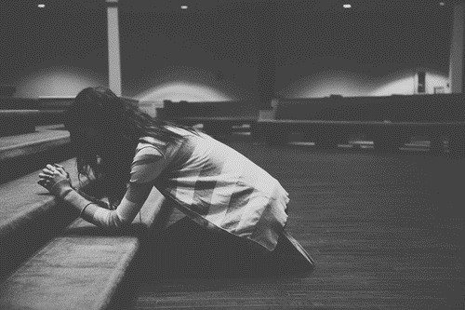
Notes:
Let’s respond to the Lord this morning… What action do you need to take?
Move and pray with someone… pray together at the altar…
Maybe you and your spouse need to pray together…
Maybe God is working on you in another way… move in obedience to Him… prayer.

